Slide 1


Learning Rules
=============================================================================
WWW.THEMLLABS.COM || contact@themllabs.com || Phone : 91-7338339898, 91-6362546088

Slide 2
Agenda
What is Learning rule
Hebbian learning rule
Perceptron learning rule
Delta learning rule
Correlation learning rule
Outstar learning rule
=============================================================================
WWW.THEMLLABS.COM || contact@themllabs.com || Phone : 91-7338339898, 91-6362546088

Slide 3
Learning Rule
It is also called learning process, It improves the training method and network performance.
It is a mathematical logic or algorithm
This is the process of updating the weights and bias in the neuron.
=============================================================================
WWW.THEMLLABS.COM || contact@themllabs.com || Phone : 91-7338339898, 91-6362546088

Slide 4
It will update the weights by comparing the expected and actual result of the network
There are several learning methods like Hebbian learning, Perceptron learning rule, Delta learning rule etc.
We will be discussing a few of them
=============================================================================
WWW.THEMLLABS.COM || contact@themllabs.com || Phone : 91-7338339898, 91-6362546088

Slide 5
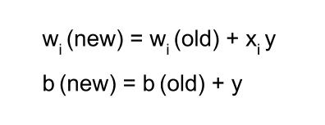
Hebbian Learning rule
It was developed by Donald Hebb which describe biological neuron firing.
This rule is used for pattern classification.
The formula for calculating weights and bias.
=============================================================================
WWW.THEMLLABS.COM || contact@themllabs.com || Phone : 91-7338339898, 91-6362546088

Slide 6
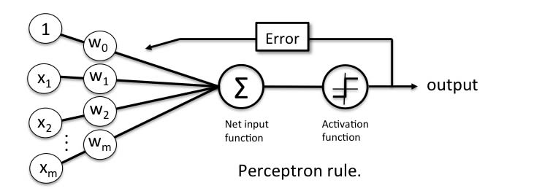
Perceptron Learning rule
This learning rule is an example of supervised training.
The activation function’s output is used for adjusting the weights
Perceptron accepts m inputs and output is only one, which is a Boolean output.
=============================================================================
WWW.THEMLLABS.COM || contact@themllabs.com || Phone : 91-7338339898, 91-6362546088

Slide 7

It will add all the inputs multiplied by specific weights
The weights are updated using the formula given below. Where n is the learning rate, t is the target value and o is the output
=============================================================================
WWW.THEMLLABS.COM || contact@themllabs.com || Phone : 91-7338339898, 91-6362546088

Slide 8
Delta Learning rule
This rule is introduced by Widrow and Hoff, it depends on supervised learning.
This rule use the difference between target activation output and obtained activation output.
It can refine few neural network with specific backpropagation.
=============================================================================
WWW.THEMLLABS.COM || contact@themllabs.com || Phone : 91-7338339898, 91-6362546088

Slide 9
Mathematical equation for delta learning rule:
∆w = µ(t-y)x
Where, ∆w is change in weights,
µ is the constant learning rate
t and Y are desired input and actual output.
=============================================================================
WWW.THEMLLABS.COM || contact@themllabs.com || Phone : 91-7338339898, 91-6362546088

Slide 10
Correlation Learning rule
This rule is based on the principal of Hebbian learning rule, but it is an example for supervised learning.
It will use desired output (dj) instead of actual output (aj) for calculating the weights.
The mathematical formula for Correlation learning rule:
∆w_{ij =} ɳX_{i}d_{j} , ɳ is the constant learning rate
=============================================================================
WWW.THEMLLABS.COM || contact@themllabs.com || Phone : 91-7338339898, 91-6362546088

Slide 11
Correlation Learning rule
This rule is based on the principal of Hebbian learning rule, but it is an example for supervised learning.
It will use desired output (dj) instead of actual output (aj) for calculating the weights.
The mathematical formula for Correlation learning rule:
∆w_{ij =} ɳX_{i}d_{j} , ɳ is the constant learning rate
=============================================================================
WWW.THEMLLABS.COM || contact@themllabs.com || Phone : 91-7338339898, 91-6362546088

Slide 12
Out Star Learning rule
This rule introduced by Grossberg, it follows supervised learning.
In this rule, the weight associated with the specific node should be same as the target output of the neurons associated with those weights.
Mathematical formula for Out Star learning rule:
∆w_{ij =} c(d_{i}-w_{ij}), c is the constant learning rate
=============================================================================
WWW.THEMLLABS.COM || contact@themllabs.com || Phone : 91-7338339898, 91-6362546088

Slide 13
Thank you
=============================================================================
WWW.THEMLLABS.COM || contact@themllabs.com || Phone : 91-7338339898, 91-6362546088

